Slide 1
Draft Dashboard Styles
Presentation to UF BOT
December 1-2, 2016
Joe Glover

Slide 2
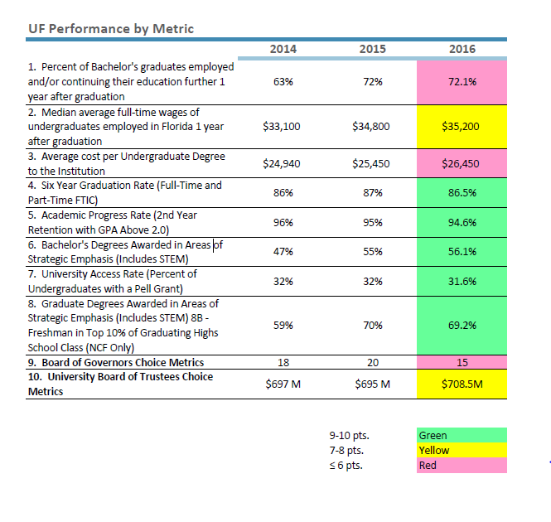

Slide 3
Performance Based Funding Metrics

Slide 4
Board of Governor’s Performance Funding DRAFT
UF
Benchmark at 10 points
Example
Sources:
2016: http://www.flbog.edu/about/budget/docs/performance_funding/PBF-2016-17-Packet.pdf
2015: http://www.flbog.edu/about/budget/docs/performance_funding/Final-Metric-Score-Sheets-Year-2.pdf
2014: http://www.flbog.edu/about/budget/docs/performance_funding/PerformanceFundingModel_1213_ScoresPlusDetail.pdf

Slide 5
Board of Governor’s Performance Funding DRAFT
UF
Benchmark at 10 points
*
*The data shown is the originally approved metric. The new proposed BOG definition shown *in the latest workplan changes the metric to include graduates making $25k and up.
Sources:
2016: http://www.flbog.edu/about/budget/docs/performance_funding/PBF-2016-17-Packet.pdf
2015: http://www.flbog.edu/about/budget/docs/performance_funding/Final-Metric-Score-Sheets-Year-2.pdf
2014: http://www.flbog.edu/about/budget/docs/performance_funding/PerformanceFundingModel_1213_ScoresPlusDetail.pdf

Slide 6
Board of Governor’s Performance Funding DRAFT
UF
Benchmark at 10 points
Sources:
2016: http://www.flbog.edu/about/budget/docs/performance_funding/PBF-2016-17-Packet.pdf
2015: http://www.flbog.edu/about/budget/docs/performance_funding/Final-Metric-Score-Sheets-Year-2.pdf
2014: http://www.flbog.edu/about/budget/docs/performance_funding/PerformanceFundingModel_1213_ScoresPlusDetail.pdf

Slide 7
Board of Governor’s Performance Funding DRAFT
Sources:
2016: http://www.flbog.edu/about/budget/docs/performance_funding/PBF-2016-17-Packet.pdf
2015: http://www.flbog.edu/about/budget/docs/performance_funding/Final-Metric-Score-Sheets-Year-2.pdf
2014: http://www.flbog.edu/about/budget/docs/performance_funding/PerformanceFundingModel_1213_ScoresPlusDetail.pdf

Slide 8
Board of Governor’s Performance Funding DRAFT
UF
Benchmark at 10 points
Sources:
2016: http://www.flbog.edu/about/budget/docs/performance_funding/PBF-2016-17-Packet.pdf
2015: http://www.flbog.edu/about/budget/docs/performance_funding/Final-Metric-Score-Sheets-Year-2.pdf
2014: http://www.flbog.edu/about/budget/docs/performance_funding/PerformanceFundingModel_1213_ScoresPlusDetail.pdf

Slide 9
Board of Governor’s Performance Funding DRAFT
UF
Benchmark at 10 points
*
*
*2016 and 2015 data are both based on 2013-14 fiscal years.
Sources:
2016: http://www.flbog.edu/about/budget/docs/performance_funding/PBF-2016-17-Packet.pdf
2015: http://www.flbog.edu/about/budget/docs/performance_funding/Final-Metric-Score-Sheets-Year-2.pdf
2014: http://www.flbog.edu/about/budget/docs/performance_funding/PerformanceFundingModel_1213_ScoresPlusDetail.pdf

Slide 10
Metrics that Matter

Slide 11
Metrics that Matter DRAFT
UF
Top 10 Threshold
Top 10 Average
Example
Undergraduate Students

Slide 12
Metrics that Matter DRAFT
UF
Top 10 Threshold
Top 10 Average
Financial Factors

Slide 13
Metrics that Matter DRAFT
UF
Top 10 Threshold
Top 10 Average
Faculty

Slide 14
Metrics that Matter DRAFT
Research Factors

Slide 15
Metrics that Matter DRAFT
UF
Top 10 Threshold
Top 10 Average
Economic Development

Slide 16
Metrics that Matter DRAFT
UF
Top 10 Threshold
Top 10 Average
Undergraduate Students

Slide 17
Metrics that Matter DRAFT
UF
Top 10 Threshold
Top 10 Average
Undergraduate Students

Slide 18
Preeminence Based Funding Metrics

Slide 19
Board of Governor’s Preeminence Funding DRAFT
UF
*Definition Change
Benchmark
Sources:
2016: http://www.flbog.edu/about/_doc/budget/workplan_2016/2016_SYSTEM_WORK_PLAN__2016-09-09.pdf (pg10)
2015: http://www.flbog.edu/about/_doc/budget/workplan_2015/2015_SYSTEM_WORK_PLAN_FINAL.pdf (pg10)
2014: http://www.flbog.edu/about/_doc/budget/workplan_2014-15/UF_2014-15_Workplan_FINAL.pdf

Slide 20
Board of Governor’s Preeminence Funding DRAFT
UF
*Definition Change
Benchmark
*
*2016 workplan only includes reading and math scores.
Sources:
2016: http://www.flbog.edu/about/_doc/budget/workplan_2016/2016_SYSTEM_WORK_PLAN__2016-09-09.pdf (pg10)
2015: http://www.flbog.edu/about/_doc/budget/workplan_2015/2015_SYSTEM_WORK_PLAN_FINAL.pdf (pg10)
2014: http://www.flbog.edu/about/_doc/budget/workplan_2014-15/UF_2014-15_Workplan_FINAL.pdf

Slide 21
Board of Governor’s Preeminence Funding DRAFT
UF
*Definition Change
Benchmark
*
*Expanded selection of national ranking from 2014 to 2015.
Sources:
2016: http://www.flbog.edu/about/_doc/budget/workplan_2016/2016_SYSTEM_WORK_PLAN__2016-09-09.pdf (pg10)
2015: http://www.flbog.edu/about/_doc/budget/workplan_2015/2015_SYSTEM_WORK_PLAN_FINAL.pdf (pg10)
2014: http://www.flbog.edu/about/_doc/budget/workplan_2014-15/UF_2014-15_Workplan_FINAL.pdf

Slide 22
Board of Governor’s Preeminence Funding DRAFT
UF
*Definition Change
Benchmark
Sources:
2016: http://www.flbog.edu/about/_doc/budget/workplan_2016/2016_SYSTEM_WORK_PLAN__2016-09-09.pdf (pg10)
2015: http://www.flbog.edu/about/_doc/budget/workplan_2015/2015_SYSTEM_WORK_PLAN_FINAL.pdf (pg10)
2014: http://www.flbog.edu/about/_doc/budget/workplan_2014-15/UF_2014-15_Workplan_FINAL.pdf

Slide 23
Board of Governor’s Preeminence Funding DRAFT
UF
*Definition Change
Benchmark
Sources:
2016: http://www.flbog.edu/about/_doc/budget/workplan_2016/2016_SYSTEM_WORK_PLAN__2016-09-09.pdf (pg10)
2015: http://www.flbog.edu/about/_doc/budget/workplan_2015/2015_SYSTEM_WORK_PLAN_FINAL.pdf (pg10)
2014: http://www.flbog.edu/about/_doc/budget/workplan_2014-15/UF_2014-15_Workplan_FINAL.pdf

Slide 24
Board of Governor’s Preeminence Funding DRAFT
UF
*Definition Change
Benchmark
*
1,592
*2016 workplan also includes medical/health professional doctorates.
Sources:
2016: http://www.flbog.edu/about/_doc/budget/workplan_2016/2016_SYSTEM_WORK_PLAN__2016-09-09.pdf (pg10)
2015: http://www.flbog.edu/about/_doc/budget/workplan_2015/2015_SYSTEM_WORK_PLAN_FINAL.pdf (pg10)
2014: http://www.flbog.edu/about/_doc/budget/workplan_2014-15/UF_2014-15_Workplan_FINAL.pdf

Slide 25
Board of Governor’s Preeminence Funding DRAFT
UF
*Definition Change
Benchmark
Sources:
2016: http://www.flbog.edu/about/_doc/budget/workplan_2016/2016_SYSTEM_WORK_PLAN__2016-09-09.pdf (pg10)
2015: http://www.flbog.edu/about/_doc/budget/workplan_2015/2015_SYSTEM_WORK_PLAN_FINAL.pdf (pg10)
2014: http://www.flbog.edu/about/_doc/budget/workplan_2014-15/UF_2014-15_Workplan_FINAL.pdf

